Slide 1
Parallel Image/Video Editor
Adam Feinstein and H. Parker Shelton, 520.443, Johns Hopkins University

Slide 2
Adam Feinstein and H. Parker Shelton, 520.443, Johns Hopkins University
Project Overview
GPU-Parallelized Image and Video Editor
Multiple Compression Algorithms

Slide 3
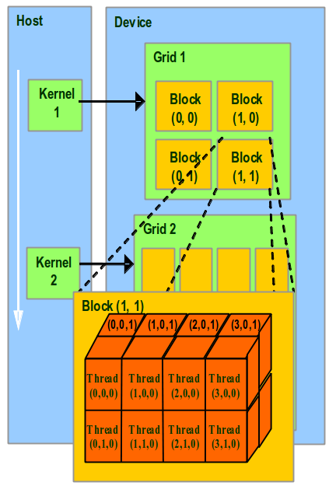
Adam Feinstein and H. Parker Shelton, 520.443, Johns Hopkins University
Nvidia’s CUDA
Compute-Unified Device Architecture
GPU (grid) divided into Blocks, Threads
Each Thread invokes the same kernel, preforms its own calculations

Slide 4
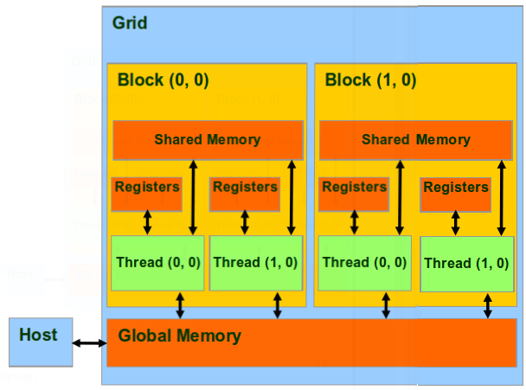
Adam Feinstein and H. Parker Shelton, 520.443, Johns Hopkins University
Nvidia’s CUDA
Threads can share memory, Blocks cannot
Memory must be copied from the host to the GPU and back again

Slide 5
Adam Feinstein and H. Parker Shelton, 520.443, Johns Hopkins University
Qt
Cross-Platform C++ GUI Framework
Multi-threading, Multimedia, WebKit, SQL

Slide 6
Adam Feinstein and H. Parker Shelton, 520.443, Johns Hopkins University
GUI Demonstration
Screenshots?
Demo?

Slide 7
Adam Feinstein and H. Parker Shelton, 520.443, Johns Hopkins University
Image Editing
Brightness
Contrast
Saturation
Grayscale
Blur
Edge Detect
Crop
Rotate
Scale
Others? – I forget?

Slide 8
Adam Feinstein and H. Parker Shelton, 520.443, Johns Hopkins University
Brightness
Source goes here

Slide 9
Adam Feinstein and H. Parker Shelton, 520.443, Johns Hopkins University
Contrast
Source goes here

Slide 10
Adam Feinstein and H. Parker Shelton, 520.443, Johns Hopkins University
Saturation
Source goes here

Slide 11
Adam Feinstein and H. Parker Shelton, 520.443, Johns Hopkins University
Rotate
Source goes here

Slide 12
Adam Feinstein and H. Parker Shelton, 520.443, Johns Hopkins University
Scale
Source goes here

Slide 13
Adam Feinstein and H. Parker Shelton, 520.443, Johns Hopkins University
Crop
Source goes here

Slide 14
Adam Feinstein and H. Parker Shelton, 520.443, Johns Hopkins University
Blur
Source goes here

Slide 15
Adam Feinstein and H. Parker Shelton, 520.443, Johns Hopkins University
Edge Detect
Source goes here

Slide 16
Adam Feinstein and H. Parker Shelton, 520.443, Johns Hopkins University
CPU vs GPU Speed Comparison

Slide 17
Adam Feinstein and H. Parker Shelton, 520.443, Johns Hopkins University
CPU vs GPU Speed Comparison

Slide 18
Adam Feinstein and H. Parker Shelton, 520.443, Johns Hopkins University
CPU vs GPU Speed Comparison

Slide 19
Adam Feinstein and H. Parker Shelton, 520.443, Johns Hopkins University
CPU vs GPU Speed Comparison
GPU Limitations:
cudaMemcpy() still runs in linear time, necessary to move data onto and off of a GPU
Resources used by operating system, failed to allocate space for a 4096x4096 image (64MB * 2)
Wavelet transform can't use __shared__ memory

Slide 20
Adam Feinstein and H. Parker Shelton, 520.443, Johns Hopkins University
Decoding
QImage-provided support for bmp, gif, jpg, png, pgm, and tif decoding
Decoding implemented for custom .ppc codec
Stored in 32-bit RGBA format internally

Slide 21
Adam Feinstein and H. Parker Shelton, 520.443, Johns Hopkins University
Encoding
QImage-provided support for bmp, jpg, png, tiff encoding with quality settings
Encoding implemented for custom .ppc codec
Huffman Compression
Arithmetic Compression
Runlength Compression
Stored in 32-bit RGBA format internally

Slide 22
Adam Feinstein and H. Parker Shelton, 520.443, Johns Hopkins University
.ppc Codec
Parallel Picture Codec
Description here

Slide 23
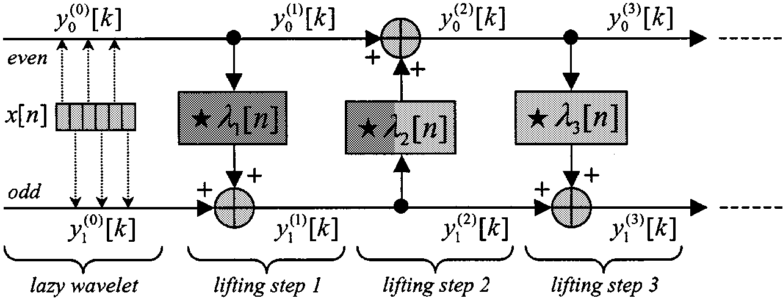
Adam Feinstein and H. Parker Shelton, 520.443, Johns Hopkins University
Compression
Discrete 9/7 Wavelet Transform, lifting implementation
Used Grigory Pau's implementation, uses exact coefficients given by Taubman and Marcellin in JPEG2000 paper
(http://www.embl.de/~gpau/misc/dwt97.c)
CPU: lightly modified, GPU: heavily modified
No color transform, still have to sort out colors
One level transform
Two predict, update filters
Use piecewise continuous function to approximate threshold for zeroing out coefficients give a desired percent of coefficients zeroed out

Slide 24
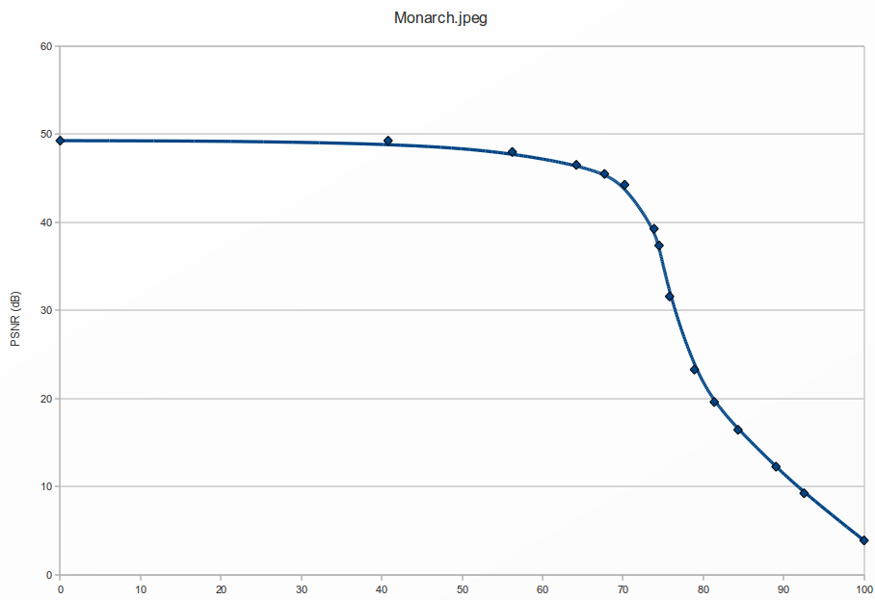
Adam Feinstein and H. Parker Shelton, 520.443, Johns Hopkins University
Compression

Slide 25
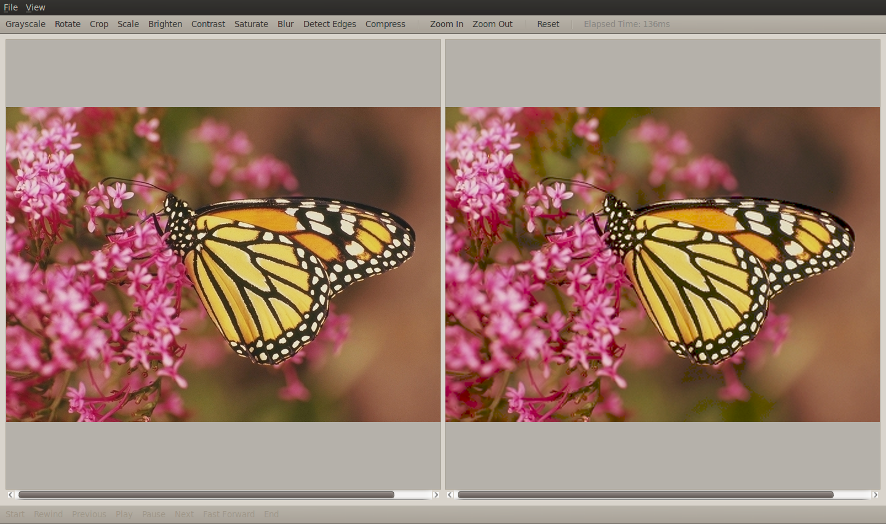
Adam Feinstein and H. Parker Shelton, 520.443, Johns Hopkins University
Compression

Slide 26
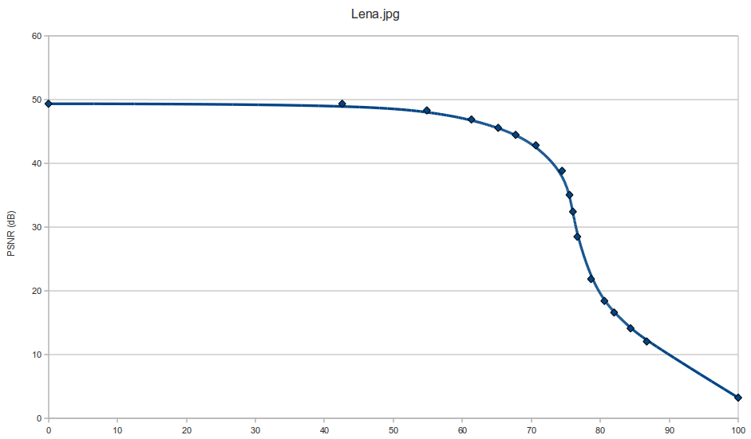
Adam Feinstein and H. Parker Shelton, 520.443, Johns Hopkins University
Compression

Slide 27
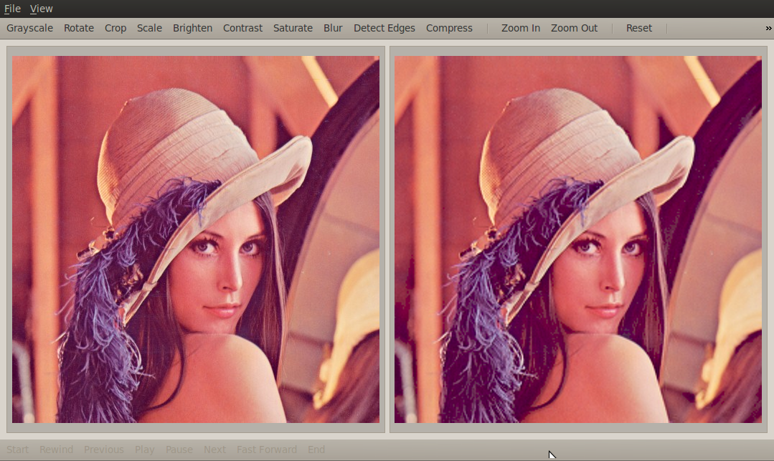
Adam Feinstein and H. Parker Shelton, 520.443, Johns Hopkins University
Compression

